Slide 1


OPERATORS IN R
INT 232

Slide 2
Operator
An operator is a symbol that tells the compiler to perform specific mathematical or logical manipulations.
R language is rich in built-in operators and provides following types of operators.

Slide 3
Types of Operators
We have the following types of operators in R programming −
🞇 Arithmetic Operators
🞇 Relational Operators
🞇 Logical Operators
🞇 Assignment Operators
🞇 Miscellaneous Operators

Slide 4
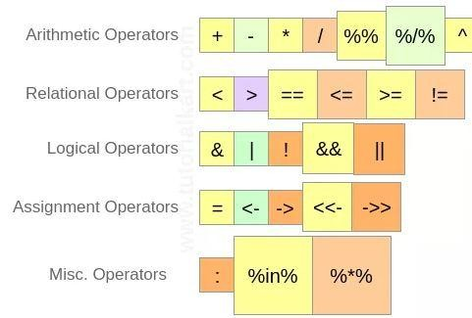

Slide 5
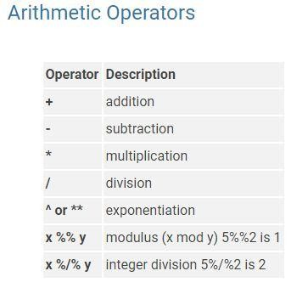

Slide 6
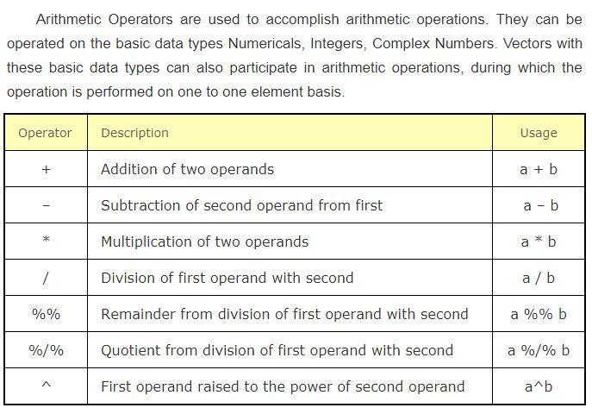

Slide 7
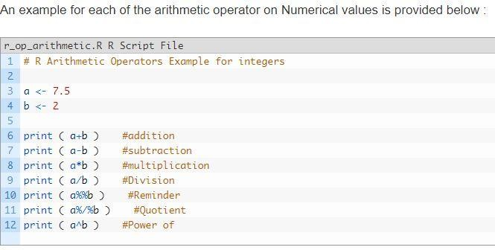


Slide 8
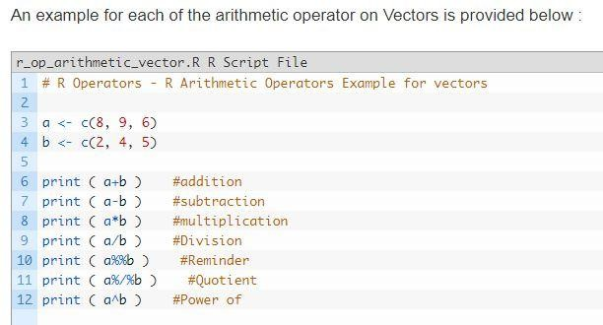
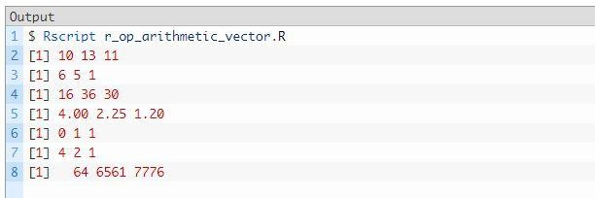

Slide 9
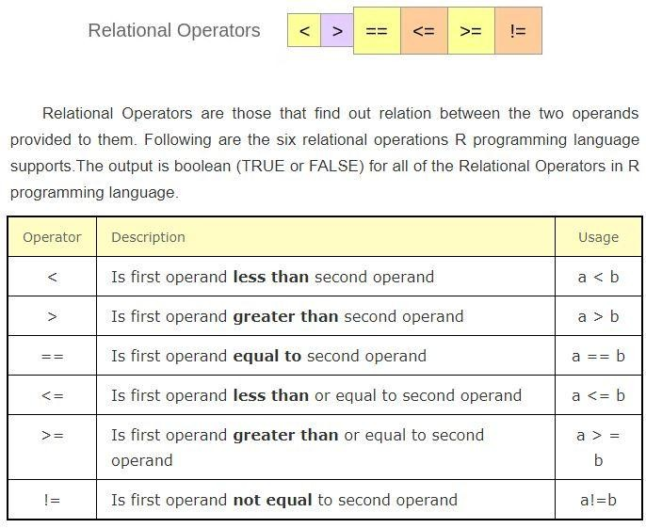

Slide 10
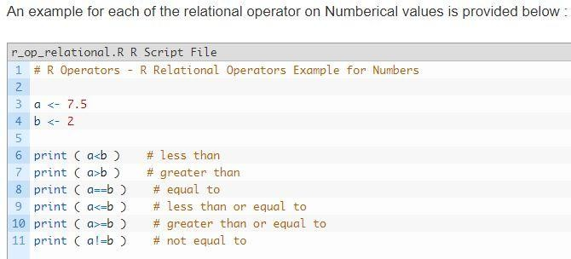


Slide 11
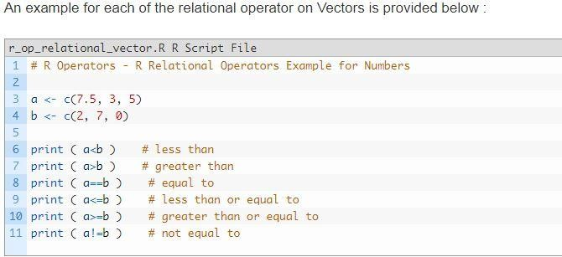


Slide 12
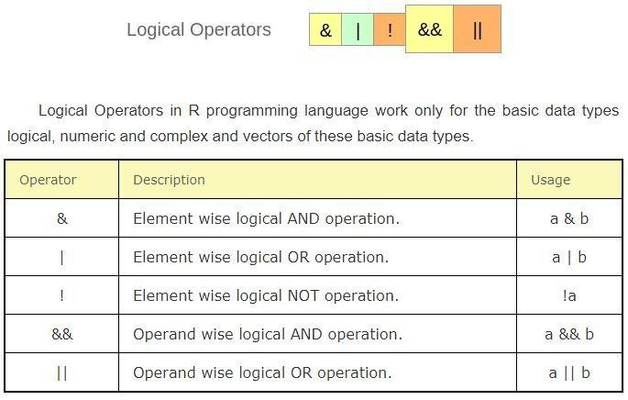

Slide 13
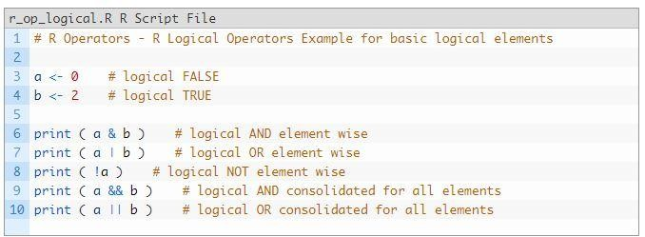


Slide 14
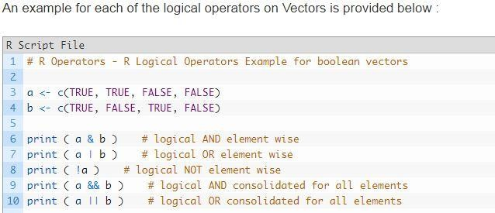


Slide 15
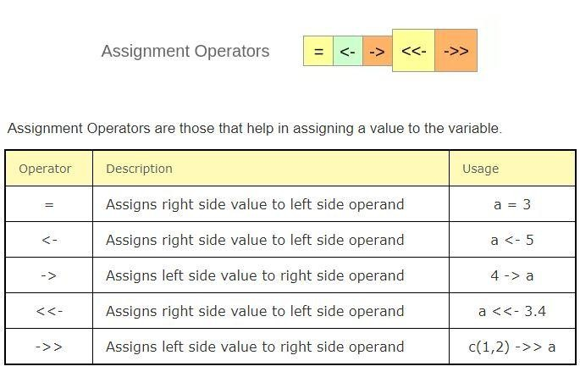

Slide 16
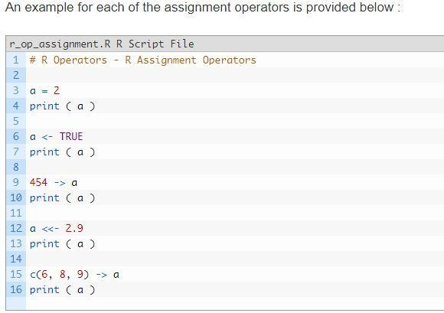
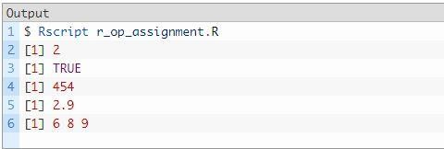

Slide 17
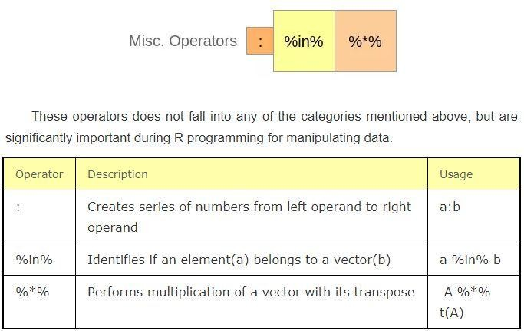

Slide 18
